Slide 1
Student Interest System
An Overview of the Application
Asma-BITF20M036

Slide 2
Introduction
The Student Interest System is a comprehensive web application designed to streamline and enhance the management of student information and interests within an educational institution. This system provides a user-friendly interface for students, administrators, and faculty members to interact with and manage various aspects related to student data and interests.
Objectives
Simplify Management:
Easy Registration: Streamlined student registration process.
Record Maintenance: Efficiently manage academic and personal information.
Enhance Communication:
Express Interests: Allow students to share academic and extracurricular interests.
Improved Communication: Facilitate better communication among students, faculty, and administrators.

Slide 3
Goals
Efficiency:
Time-Saving: Save time in managing student information.
Quick Access: Provide quick access for administrators and faculty.
Accuracy:
Up-to-Date Records: Maintain up-to-date and accurate student records.
Error Minimization: Minimize errors in data handling.
Adaptability:
Scalable Solution: Design a solution that can adapt to future enhancements.
Institutional Changes: Accommodate changes in institutional requirements.
Security:
Robust Measures: Implement robust security measures for data protection.
Regulatory Compliance: Ensure compliance with relevant regulations.

Slide 4
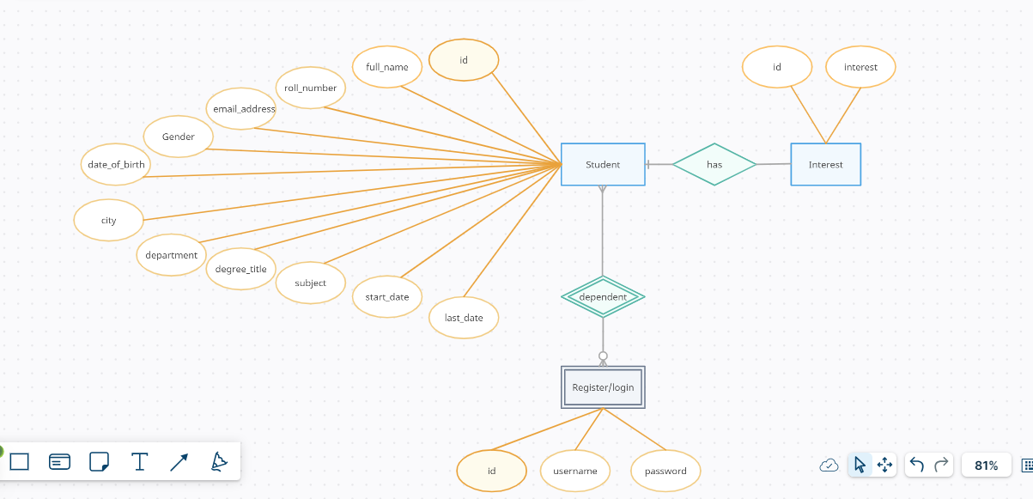
Entity Relationship Diagram
Entities: Student, Interest, Register

Slide 5
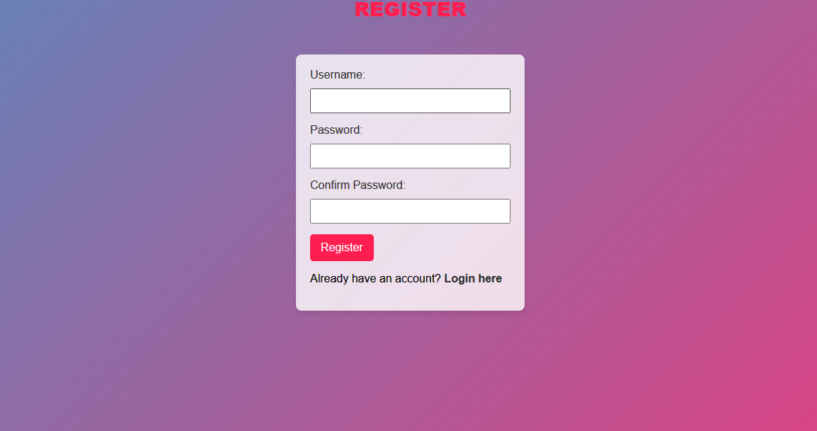
Application Flow
I used hover styling in background that's why screen background colours changed
Register:

Slide 6
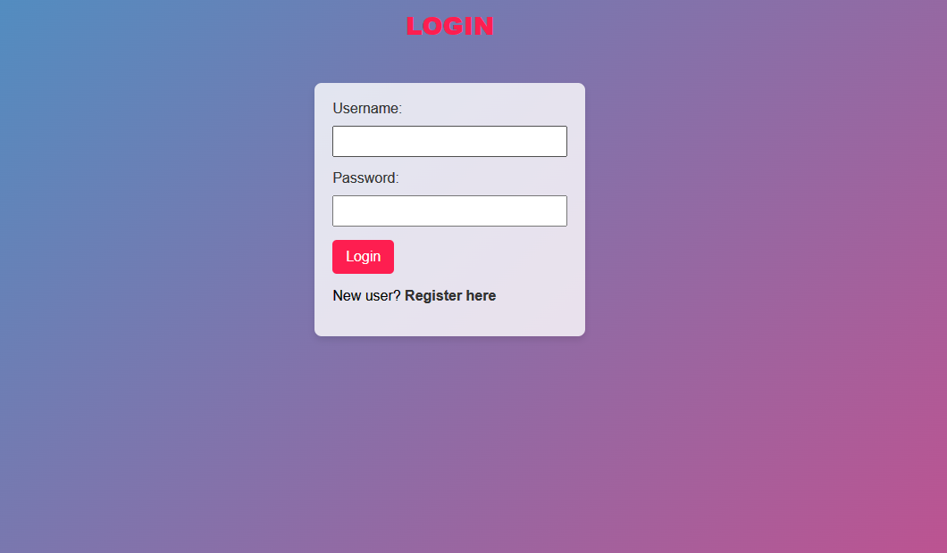
Login:

Slide 7
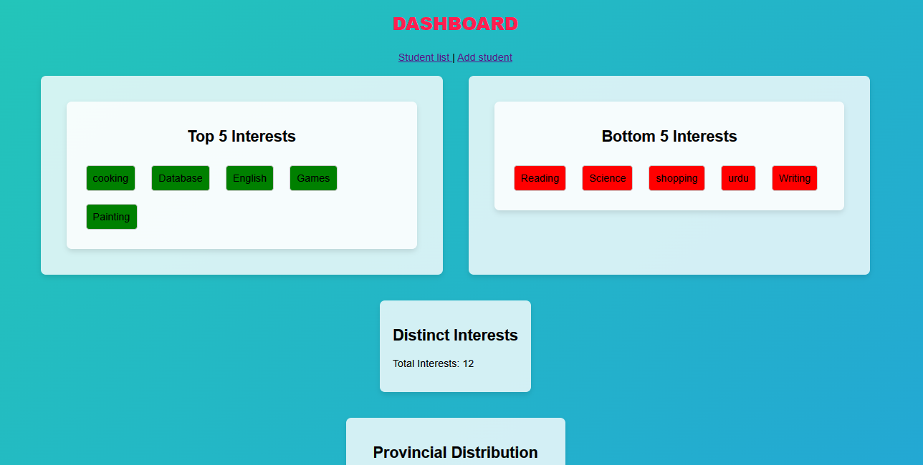
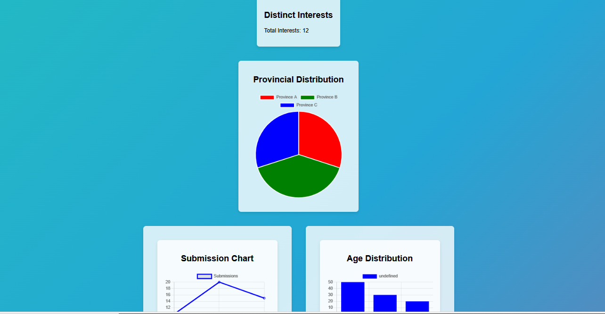
Dashboard:

Slide 8
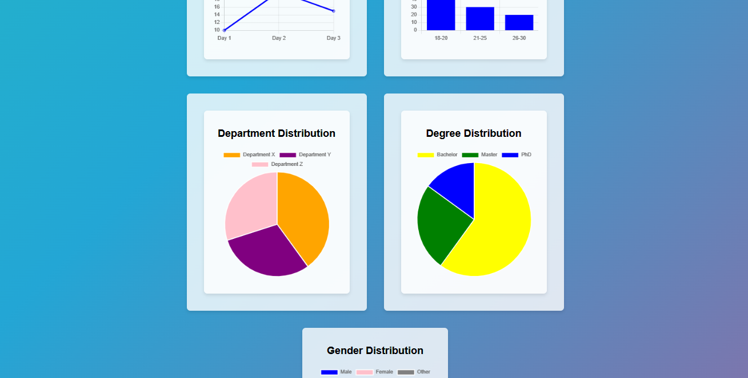
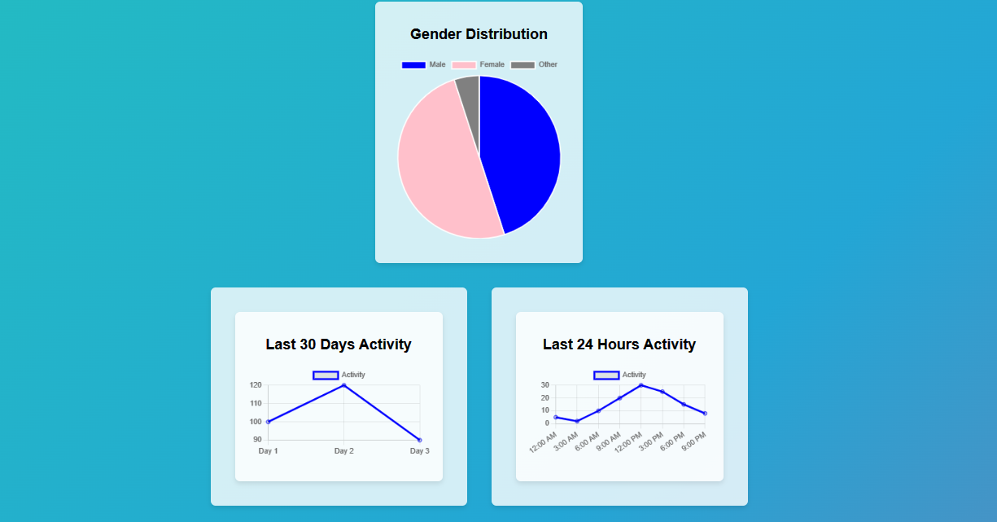

Slide 9
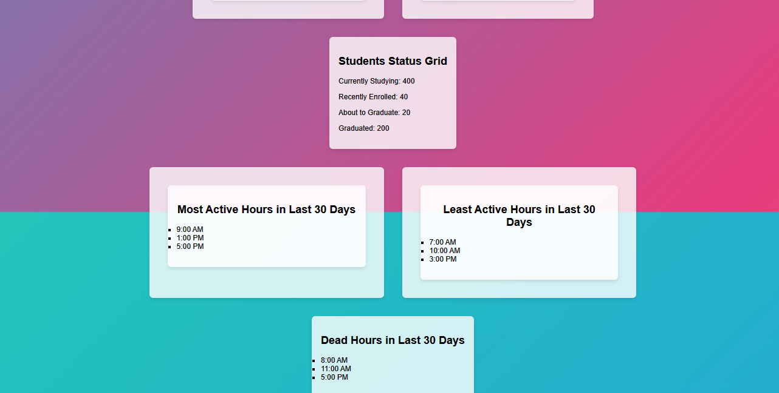

Slide 10
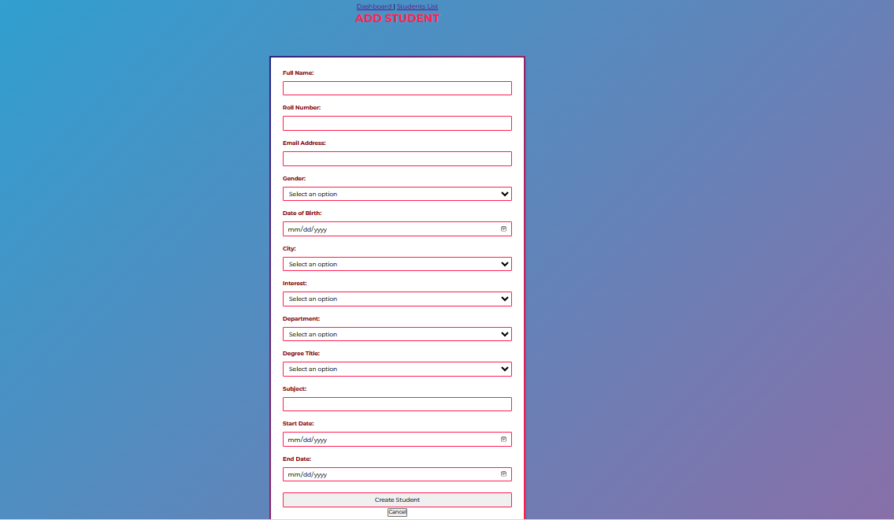
Add Student:

Slide 11
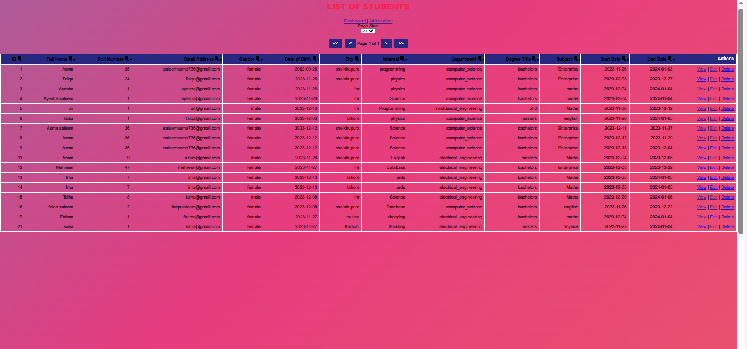
Student List:

Slide 12
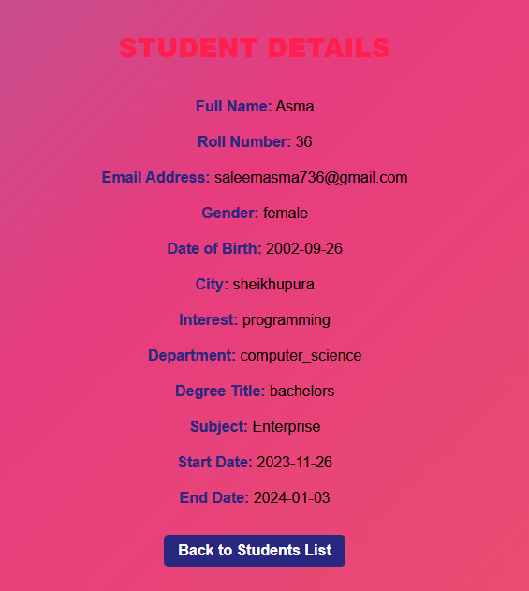
View Student:

Slide 13
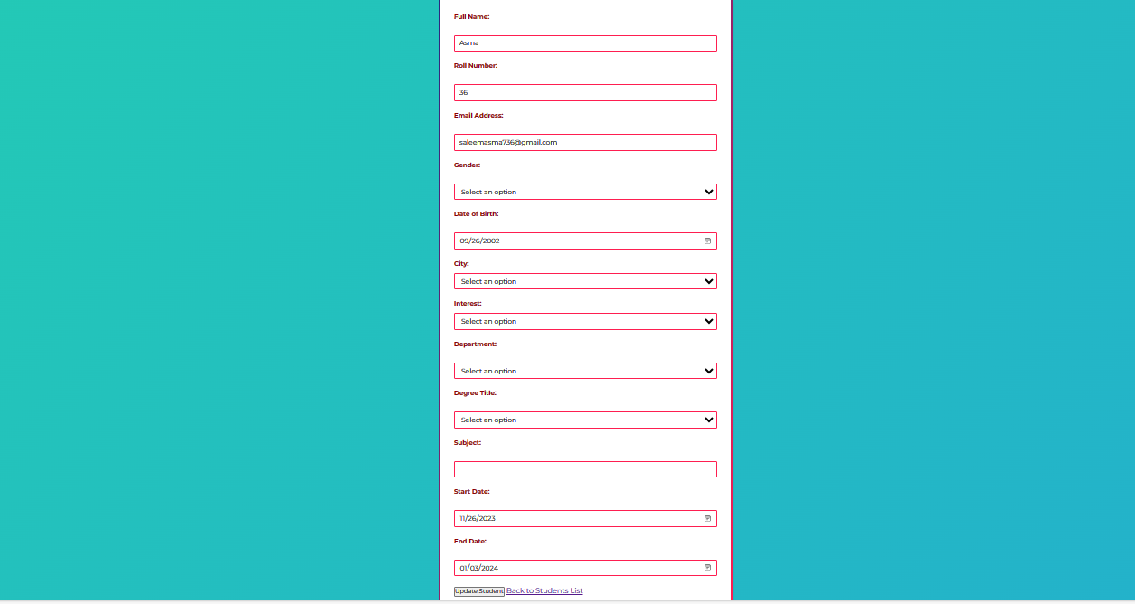
Edit Student:

Slide 14
Technologies:
Flask: Flask is a lightweight web framework for Python. It's used here to handle routing, request handling, and rendering templates. As a micro-framework, it provides the necessary tools to build a robust web application without unnecessary complexity. This is the reason i choose flask for my project.
Pymysql: This library is used to connect to a MySQL database. It facilitates the interaction between the Python application and the database. Html/css/js.
Template:
The code uses HTML templates to render the views. For example, add_student.html, display_students.html, view_student.html, edit_student.html, dashboard.html, Register.html, and login.html are templates that render different pages of the application.

Slide 15
Color Scheme:
Background Gradient: Colors: #ee7752, #e73c7e, #23a6d5, #23d5ab This creates a gradient background that transitions between shades of orange, pink, light blue, and green. I use hover Effect.
Form Background: Light gray background for the form.
Text Colors:
White (#fff) for header text.
Dark red (#darkred) for label text.
Various shades of blue and red for form input borders and button gradients.
Fonts:
Font Family:
Montserrat, sans-serif .
The Montserrat font is used for all text, providing a clean and modern look.

Slide 16


